Slide 1
Channel Access Methods
Valery Kasyanik

Slide 2
Definition
channel access method or multiple access method allows several terminals connected to the same multi-point transmission medium to transmit over it and to share its capacity.
Examples of shared physical media are wireless networks, bus networks, ring networks and half-duplex point-to-point links.

Slide 3
Channel Access Methods
When several devices are connected to a single channel, there must be some rules to govern these devices as they access, transmit, and release the channel.
There are three basic channel access methods:
  Contention
  Polling
  Token passing
Different access methods have different overhead effects on network traffic.

Slide 4
Contention
With contention systems, network devices may transmit whenever they want
No referee mandates when a device may or may not use the channel
This scheme is simple to design
The scheme provides equal access rights to all stations
Stations simply transmit whenever they are ready, without considering what other stations are doing
Unfortunately, the "transmit whenever ready" strategy has one important shortcoming
Stations can transmit at the same time
When this happens, the resulting co-mingling of signals usually damages both to the point that a frame's information is lost
This unhappy event is called a "collision"

Slide 5
Collision
Newer contention protocols were developed that called for stations to listen to the channel first before transmitting.
If the listening station detects a signal, it will not start transmitting and try again later.
These protocols are called CSMA (Carrier Sense, Multiple Access with collision detection) protocols.
These protocols will reduce collisions.
However, collisions may still occur when two stations sense the cable, detect nothing, and subsequently transmit.
In order to reduce collisions, CSMA/CD protocols compute a random backoff time before retransmitting the frame (as shown in the flow diagram).
Examples of CSMA/CD protocols :
EEE 802.3 (Ethernet )

Slide 6
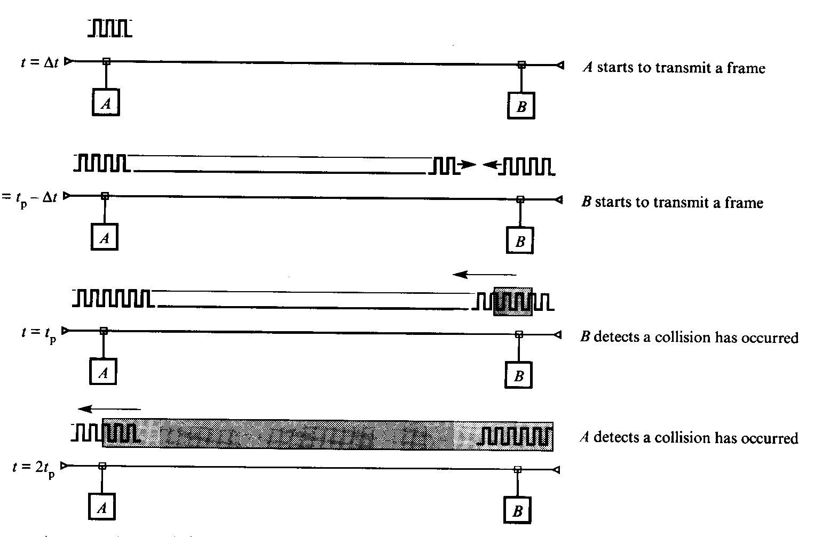
CSMA / CD collision schematic

Slide 7
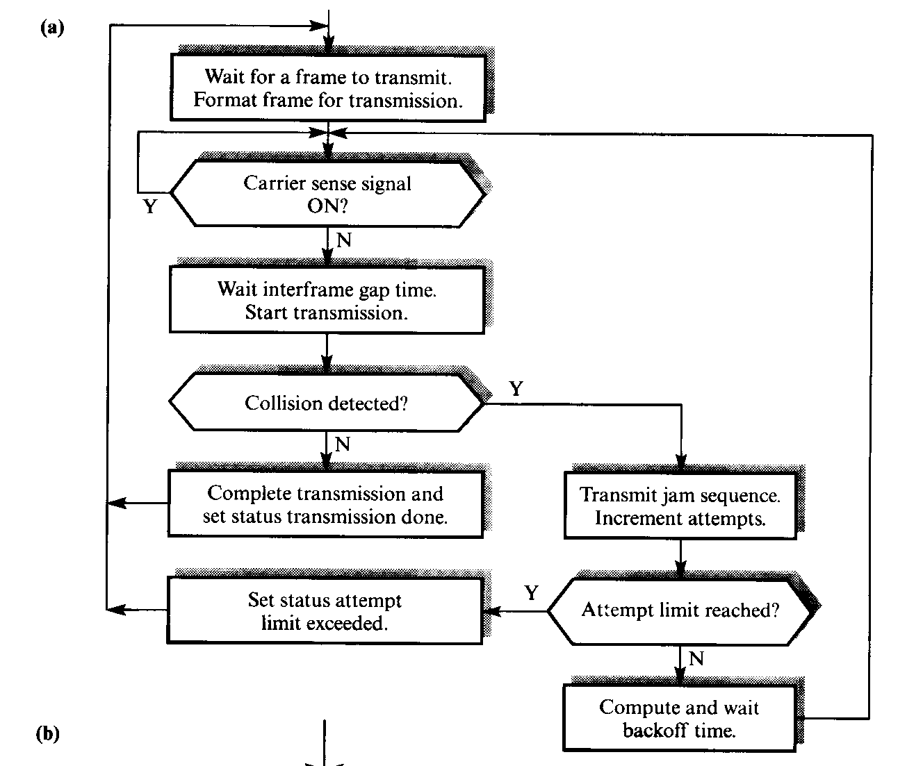
CSMA/CD operation: a) transmit

Slide 8
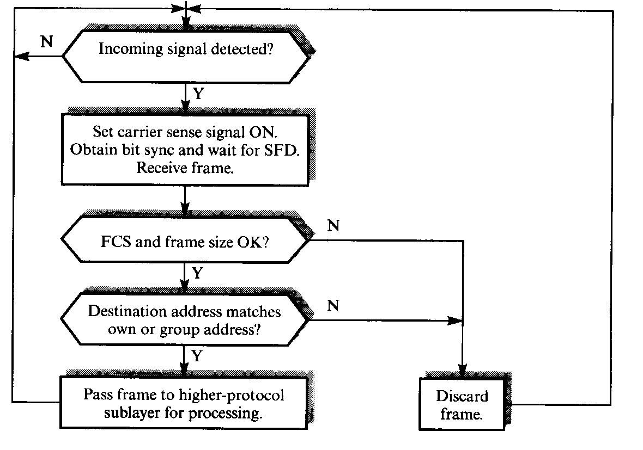
CSMA / CD operation: b) receive

Slide 9
Advantages
  CSMA/CD control software is relatively
  simple and produces little overhead.
  CSMA/CD network works best on a bus
  topology with bursty transmission.

Slide 10
Disadvantages
  CSMA/CD protocols are probabilistic and depends on the network (cable) loading.
  Considered unsuitable for channels controlling automated equipment that must have certain control over channel access. (This could be OK for different channel access).
  We can set priorities to give faster access to some devices (This is, probably, not an issue in some applications)

Slide 11
Polling access method
Polling is an access method that designates one device (called a "controller", "primary", or "master") as a channel access administrator.
This device (Master) queries each of the other devices (“secondaries”) in some predetermined order to see whether they have information to transmit.
If so, they transmit (usually through the master).

Slide 12
Polling access method
Secondaries may be linked to the master in many different configurations.
One of the most common polling topologies is a star, where the points of the star are secondaries and the master is the hub.
To get data from a secondary, the master addresses a request for data to the secondary, and then receives the data from the secondary sends (if secondary sends any).
The primary then polls another secondary and receives the data from the secondary, and so forth.
System limits how long each secondary can transmit on each poll.

Slide 13
Advantages
  Polling centralizes channel access control.
  Maximum and minimum access times and data rates on the channel are predictable and fixed.
  Priorities can be assigned to ensure faster access from some secondaries.
  Polling is deterministic and is considered suitable for channels controlling some kinds of automated equipment.

Slide 14
Disadvantages
  Polling systems often use a lot of bandwidth sending notices and acknowledgments or listening for messages.
  Line turnaround time on a half- duplex line further increases time overhead.
  This overhead reduces both the channel's data rate under low loads and its throughput.

Slide 15
Token passing System
In token-passing systems, a small frame (the token) is passed in an orderly fashion from one device to another.
A token is a special authorizing message that temporarily gives control of the channel to the device holding the token.
Passing the token around distributes access control among the channel's devices.
Each device knows from which device it receives the token and to which device it passes the token. (see fig.)
Each device periodically gets control of the token, performs its duties, and then retransmits the token for the next device to use.
System rules limit how long each device can control the token.

Slide 16
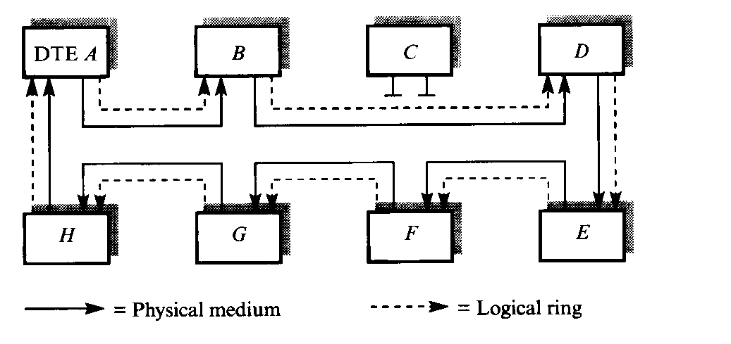
Control token MAC: Token ring

Slide 17
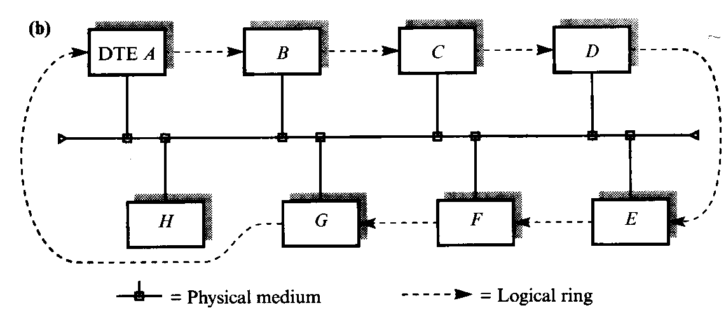
Control token MAC: Token bus

Slide 18
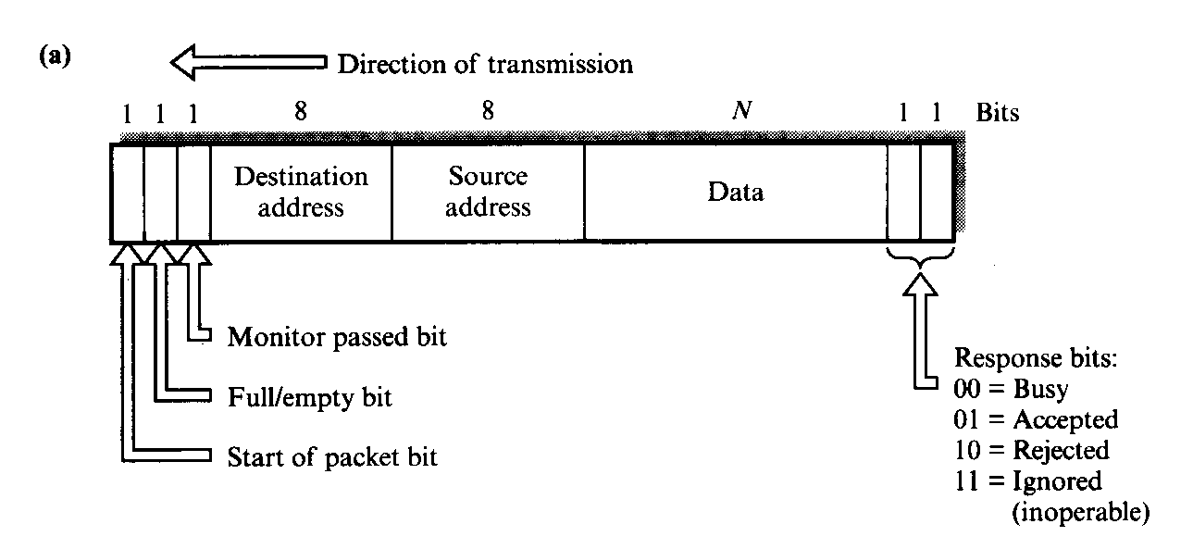
Slotted ring principles: bit definitions of each slot

Slide 19
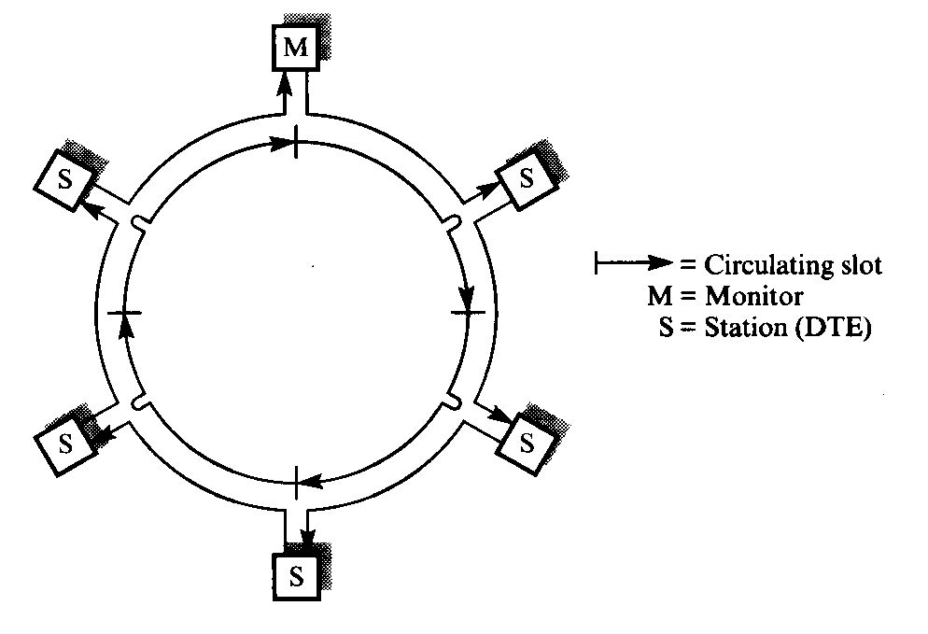
Slotted ring principles:Outline topology

Slide 20
Advantages
Even though there is more overhead using tokens than using CSMA/CD, performance differences are not noticeable with light traffic and are considerably better with heavy loads because CSMA/CD will spend a lot of time resolving collisions.
A deterministic access method such as Token Ring guarantees that every node will get access to the network within a given length of time. In probabilistic access method (such as CSMA/CD) nodes have to check for network activity when they want to access the network.

Slide 21
Disadvantages
Components are more expensive than for Ethernet or ARCnet.
Token Ring architecture is not very easy to extend to wide-area networks (WANs).
Token Ring network is much more expensive than Ethernet. This is due to the complex token passing protocol.

Slide 22
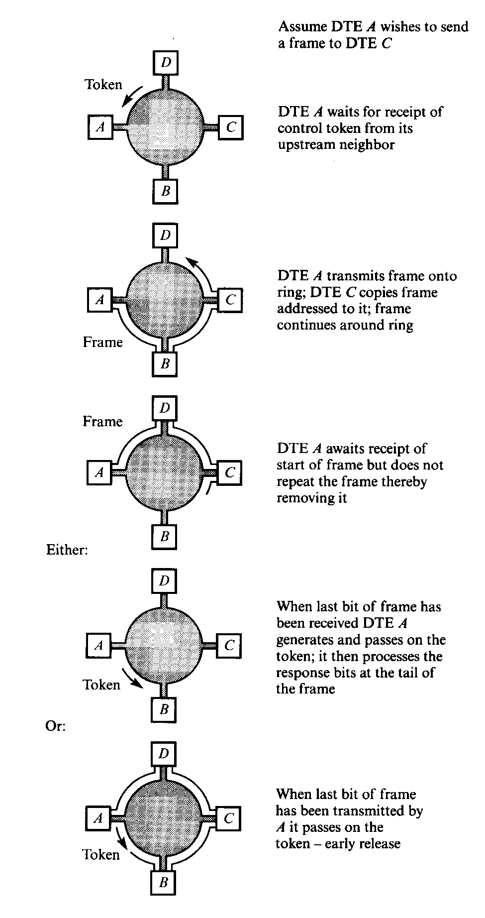
Token Ring

